Slide 1
Sentiment Classification of Twitter Data: American Airlines Customer Service
Amir Ghaderi
Mezbah Uddin
Md. Shariful Islam
MSc Data Science and Analytics

Slide 2
Overview
Problem and Goal
Data Preprocessing
Sentiment analysis
Text analysis
Classification
Network analysis
Conclusions

Slide 3
Problem and Goal
Problem
Airlines using twitter for Customer Service reasons
How to extract relevant information from large amounts of tweets
Goal
Develop a system for airline companies to process mass amounts of twitter data in an streamlined approach

Slide 4



Data Preprocessing
Twitter Search API
Keywords{“@Delta”, “@WestJet”}
Three Visualizations
Distribution of tweet length
Number of Unique Users
Retweet Percentage

Slide 5

Sentiment Analysis: SentiSrength
Positive
Positive >= 2 and Negative = -1
Negative
Positive >= 2 and Negative = -1
Neutral
Not Positive and Not Negative

Slide 6
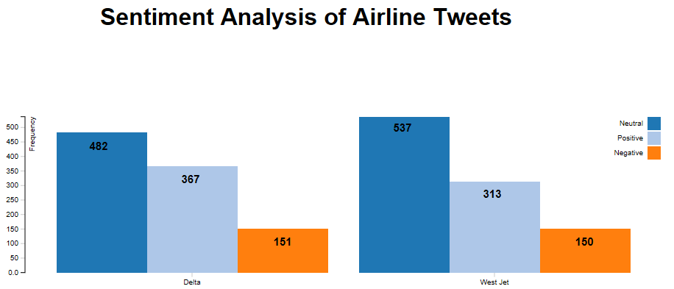
Sentiment Analysis

Slide 7
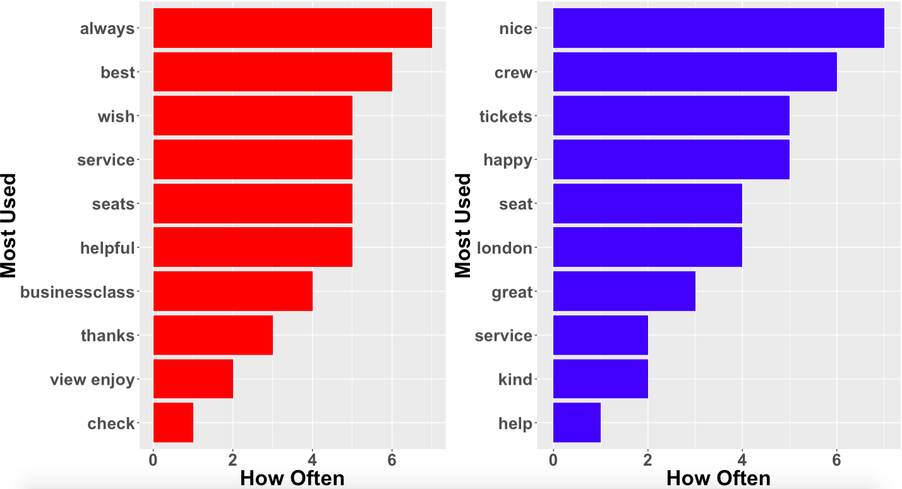
Text Analysis: Positive words
Delta
WestJet

Slide 8
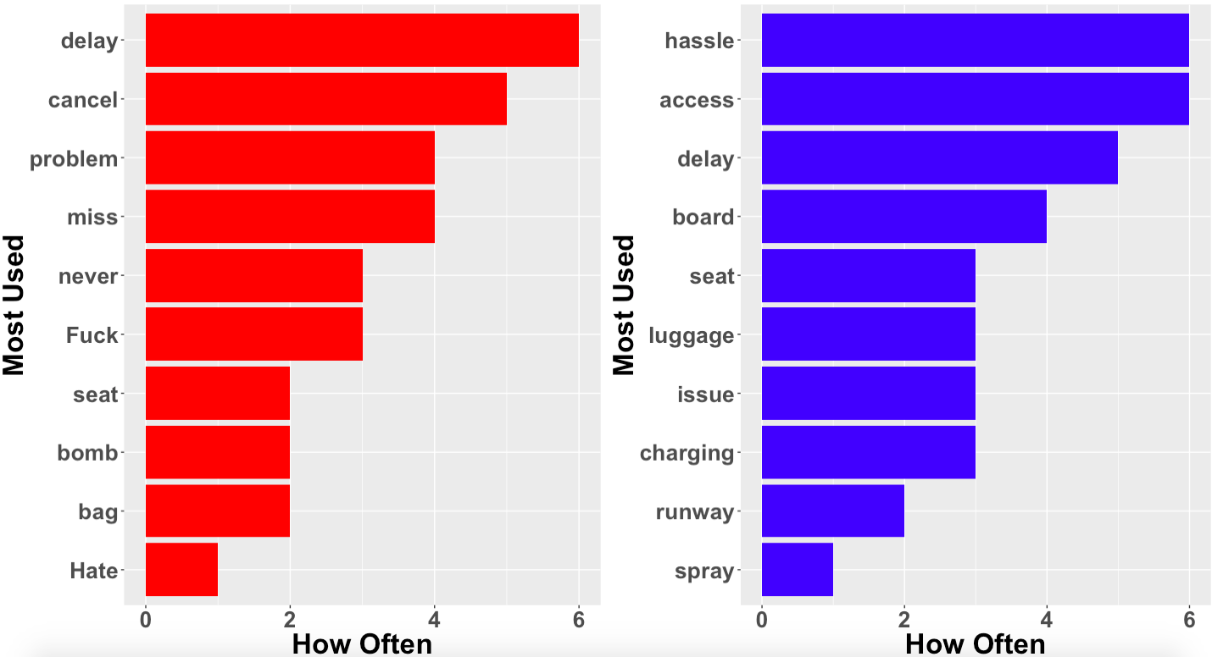
Text Analysis: Negative words
Delta
WestJet

Slide 9
Classification
Classifiers{Max Entropy, Tree Method, SVM, Random Forest, Bagging}
4 Fold Cross Validation
Delta
Training size - 400 Tweets
Testing size -127
WestJet
Training size - 363 Tweets
Testing size -100

Slide 10
Classification: Delta
 | Fold 1 | Fold 2 | Fold 3 | Fold 4 | Average
Max Entropy | 100% | 100% | 100% | 100% | 100%
Tree Method | 77% | 74% | 79% | 73% | 73%
SVM | 88% | 86% | 80% | 85% | 85.1%
Random Forest | 84% | 76% | 85% | 73% | 79%
Bagging | 85% | 82% | 78% | 81% | 82%

Slide 11
Classification: WestJet
 | Fold 1 | Fold 2 | Fold 3 | Fold 4 | Average
Max Entropy | 95% | 91% | 93% | 90% | 92%
Tree Method | 55% | 58% | 65% | 64% | 64%
SVM | 68% | 58% | 65% | 64% | 85.1%
Random Forest | 68% | 68% | 73% | 62% | 68%
Bagging | 65% | 61% | 65% | 63% | 63%

Slide 12
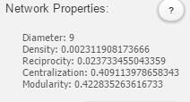
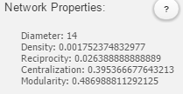
Network analysis

Slide 13
Conclusion
Social Media Viable Platform For Customer Service
Developed a system to process tweets
Sentiment analysis {positive, Negative, Neutral}
Text analytics {Relevant Word frequencies}
Machine Learning Classifiers
Network Analysis

Slide 14

Questions

